Slide 1
Case study II Prediction of Algae bloom
Siva

Slide 2
High concentrations of certain harmful algae in rivers constitute a serious ecological problem with a strong impact not only on river lifeforms, but also on water quality.
Several water samples were collected in different European rivers at different times during a period of approximately 1 year.
For each water sample, different chemical properties were measured as well as the frequency of occurrence of seven harmful algae.
Obtaining models that are able to accurately predict the algae frequencies based on chemical properties would facilitate the creation of cheap and automated systems for monitoring harmful algae blooms.

Slide 3
The data available for this problem was collected in the context of the ERUDIT1 research Network and used in the COIL 1999 international data analysis competition. It is available from several sources, such as in the UCI Machine Learning Repository of data sets.
There are two main datasets for this problem. The first consists of data for 200 water samples.
Each observation contains information on 11 variables.
Three of these variables are nominal and describe the season of the year when the water samples to be aggregated were collected, as well as the size and speed of the river in question.
Maximum pH value
Minimum value of O2 (oxygen)
Mean value of Cl (chloride)
Mean value of NO− 3 (nitrates)
Mean value of NH+4 (ammonium)
Mean of PO3− 4 (orthophosphate)
Mean of total PO4 (phosphate)
Mean of chlorophyll

Slide 4
Associated with each of these parameters are seven frequency numbers of different harmful algae found in the respective water samples.
The main goal of our study is to predict the frequencies of the seven algae for these 140 water samples.
In this type of task, our main goal is to obtain a model that allows us to predict the value of a certain target variable given the values of a set of predictor variables.
This model may also provide indications on which predictor variables have a larger impact on the target variable; that is, the model may provide a comprehensive description of the factors that influence the target variable.

Slide 5

Data
The book website
http://www.liaad.up.pt/~ltorgo/DataMiningWithR/.

Slide 6
Training data
> algae <- read.table('Analysis.txt',
+ header=F,
+ dec='.',
+ col.names=c('season','size','speed','mxPH','mnO2','Cl',
+ 'NO3','NH4','oPO4','PO4','Chla','a1','a2','a3','a4',
+ 'a5','a6','a7'),
+ na.strings=c('XXXXXXX'))
The parameter header=F indicates that the file to be read does not include a first line with the variables names. dec=’.’ states that the numbers use the ’.’ character to separate decimal places.

Slide 7
Actions:
A first idea of the statistical properties of the data can be obtained through a summary of its descriptive statistics:
summary(algae);
hist(algae$mxPH, prob = T)
It could be seen that the values of variable mxPH apparently follow a
distribution very near the normal distribution, with the values nicely clustered around the mean value.
Q-Q plot: The second graph shows a Q-Q plot obtained with the qq.plot() function, which plots the variable values against the theoretical quantiles of a normal distribution (solid black line).
The function also plots an envelope with the 95% confidence interval of the normal distribution (dashed lines). As we can observe, there are several low values of the variable that clearly break the assumptions of a normal distribution with 95% confidence.

Slide 8
Understand the use of the box plot:
boxplot(algae$oPO4, ylab = "Orthophosphate (oPO4)")
rug(jitter(algae$oPO4), side = 2)
abline(h = mean(algae$oPO4, na.rm = T), lty = 2)
Outliers:
Sometimes when we encounter outliers, we are interested in inspecting the observations that have these “strange” values.
We will show two ways of doing this. First, let us do it graphically. If we plot the values of variable NH4, we notice a very large value. We can identify the respective water sample by:
> plot(algae$NH4, xlab = "")
> abline(h = mean(algae$NH4, na.rm = T), lty = 1)
> abline(h = mean(algae$NH4, na.rm = T) + sd(algae$NH4, na.rm = T), lty = 2)
> abline(h = median(algae$NH4, na.rm = T), lty = 3)
> identify(algae$NH4)

Slide 9
Test:
algae[!is.na(algae$NH4) & algae$NH4 > 19000,]
Conditioned plots:
Conditioned plots are graphical representations that depend on a certain factor.
A factor is a nominal variable with a set of finite values. For instance, we can obtain a set of box plots for the variable a1, for each value of the variable size.
Each of the box plots was obtained using the subset of water samples that have a certain value of the variable size.
These graphs allow us to study how this nominal variable may influence the distribution of the values of a1. The code to obtain the box plots is
> library(lattice)
> bwplot(size ~ a1, data=algae, ylab='River Size',xlab='Algal A1')
➔ (plot a1 for each value of size)

Slide 10
An interesting variant of this type of plot that gives us more information on the distribution of the variable being plotted, are box-percentile plots, which are available in package Hmisc.
Let us see an example of its use with the same algal a1 against the size of rivers:
library(Hmisc)
> bwplot(size ~ a1, data=algae,panel=panel.bpplot, probs = seq(.01,.49,by=.01), datadensity=TRUE, ylab = 'River Size',xlab='Algal A1')

Slide 11
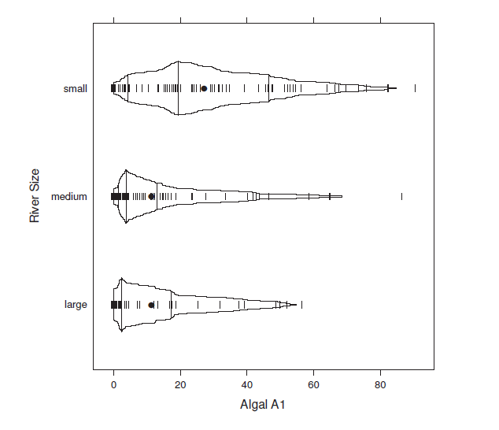

Slide 12
Unknown values:
Removing the observations with unknown values
Know the count
Before eliminating all observations with at least one unknown value in some variable, it is always wise to have a look, or at least count them:
> algae[!complete.cases(algae),]
...
...
nrow(algae[!complete
The function complete.cases() produces a vector of Boolean values with as many elements as there are rows in the algae data frame, where an element is true if the respective row is “clean” of NA values.cases(algae),])

Slide 13
For removal with NA values, use
algae <- na.omit(algae)
‘apply’ function
In the case of the function apply(), we can use it to apply any function to one of the dimensions of a multidimensional object.
Using the apply() function we are executing a function on all rows of the data frame.
This function, specified on the third argument of apply(), will be called with each row of the data frame. The function we have provided is in this case a temporary function.
It is temporary because it only exists within the call of the apply().

Slide 14
Filling in the Unknowns with the Most Frequent Values
For instance, the sample algae[48,] does not have a value in the variable mxPH. As the distribution of this variable is nearly normal we could use its mean value to fill in the “hole”.
This could be done by
> algae[48, "mxPH"] <- mean(algae$mxPH, na.rm = T)
na.rm=T disregards any NA values in this vector from the calculation
Most of the time we will be interested in filling in all unknowns of a column instead of working on a case-by-case basis as above.
Analyse
algae[is.na(algae$Chla), "Chla"] <- median(algae$Chla, na.rm = T)
The function centralImputation(), available in the book package, fills in all unknowns in a dataset using a statistic of centrality.

Slide 15
Filling in the Unknown Values by Exploring Correlations
The form of the linear correlation between the variables can be found by using
lm(PO4 ~ oPO4, data = algae)
Filling in the Unknown Values by linear models
The function lm() can be used to obtain linear models of the form Y =
β0 X1+. . .+βnXn.
The resulting coefficients and constant can be used to compute the values for missing points.
Understand the function ‘sapply’.
Filling in the Unknown Values by Exploring Similarities between Cases
The approach described in this section assumes that if two water samples are similar, and one of them has an unknown value in some variable, there is a high probability that this value is similar to the value of the other sample.

Slide 16
Multiple linear regression
Nevertheless, before we apply this method, we will remove water samples number 62 and 199 because, as mentioned before, they have six of the eleven predictor variables missing.
The following code obtains a data frame without missing values:
> data(algae)
> algae <- algae[-manyNAs(algae), ]
clean.algae <- knnImputation(algae, k = 10)
Obtain a linear regression model for predicting the frequency of one of the algae.
lm.a1 <- lm(a1 ~ ., data = clean.algae[, 1:12])
summary(lm.a1)

Slide 17
Lookiing at the summary,
R has created three auxiliary variables for the factor season (seasonspring, seasonsummer, and seasonwinter).
This means that if we have a water sample with the value “autumn” in the variable season, all three auxiliary variables will be set to zero.
For statistical analysis please refer to page 82.
Choose the null hypothesis as beta1=beta2=…=0
Check R square, F test and p value.
Try ANOVA.

Slide 18
The update() function can be used to perform small changes to an existing linear model.
In this case we use it to obtain a new model by removing the variable season from the lm.a1 model.
The summary information for this new model is given below.
lm2.a1 <- update(lm.a1, . ~ . - season)
Complete the analysis

Slide 19
Decision tree(regression tree)
>library(rpart)
> data(algae)
> algae <- algae[-manyNAs(algae), ]
> rt.a1 <- rpart(a1 ~ ., data = algae[, 1:12])

Slide 20
Error analysis
Please read

